Slide 1

DuPont Tyler Middle
Mission and Vision
Please sit in a group. Thanks!
May 15, 2017
Margie Johnson, Ed.D.

Slide 2

Outcomes
Our outcomes today are to use the collaborative inquiry process for begin developing the vision and mission statements for DuPont Tyler Middle Prep.

Slide 3
Brainstorming Vision
Individually, write down your thoughts….
What is your vision for DuPont Tyler Middle?
Adapted from Groups at Work – 2011--MiraVia LLC

Slide 4
How do we bridge the gap between data and results, so all students have educational success? What is the bridge made of?
Collaborative
Inquiry
Data
Results
Love, 2009

Slide 5

MNPS Collaborative Inquiry
Collaborative Inquiry is a data-based team process that consciously uses the collaborative learning cycle (activating and engaging, exploring and discovering, and organizing and integrating) and the qualities of effective groups (fostering a culture of trust, maintaining a clear focus, taking collective responsibility and data-informed decision-making).
MNPS Collaborative Inquiry Community of Practice

Slide 6
Collaborative Learning Cycle
Organizing and Integrating
What inferences, explanations, or conclusions might we draw?
What additional data sources might verify our explanations?
What solutions might we explore?
What data will we need to guide implementation?
Activating and Engaging
What assumptions do we bring?
What are some predictions we are making?
What questions are we asking?
What are some possibilities for learning?
Managing
Modeling
Mediating
Monitoring
Exploring and Discovering
What important points seem to pop out?
What patterns, categories, or trends are emerging?
What seems to be surprising or unexpected?
What are some ways we have not yet explored these data?
--Lipton, L. & Wellman, B. (2012). Got data? Now what? Bloomington, IN: Solution Tree, Inc.

Slide 7
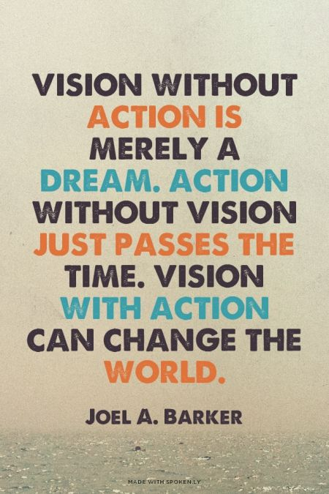
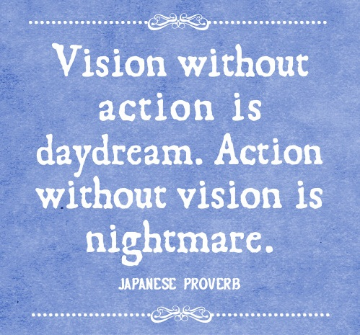
Vision

Slide 8
Exploring & Discovering: Vision and Mission
Quads:
  Letter off A-B-C-D:
  A – read page 1
  B – read page 2
  C – read page 3
  D – read page 4
  Summarize your assigned reading in 1-2 sentences.
  Share the summary with your quad.

Slide 9
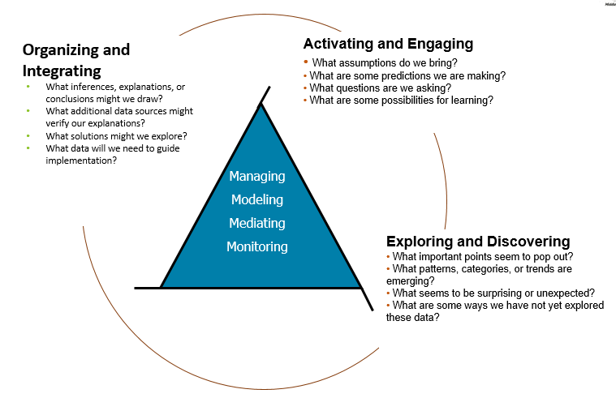
Organizing and Integrating

Slide 10

Organizing and Integrating
Develop a vision and mission statement.
Write it on chart paper.

Slide 11

Exit Ticket Reflection
Given what we have discussed and learned today, what might be some actions you take?

Slide 12

Feedback---
How Was Today’s Meeting
Individually
  Use a post-it note to provide feedback.

Slide 13
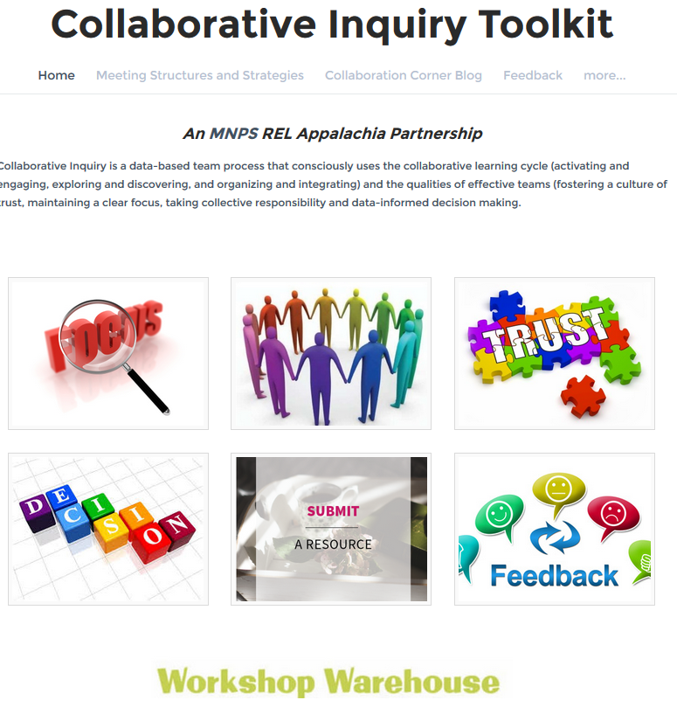


MNPS Collaborative Inquiry Toolkit
www.mnpscollaboration.org

Slide 14
References
Evans, J. (2010). Vision and mission: What’s the difference and why does it matter? Psychology Today website. Retrieved from https://www.psychologytoday.com/blog/smartwork/201004/vision-and-mission-whats-the-difference-and-why-does-it-matter
Lipton, L. & Wellman, B. (2012). Got data? Now what? Bloomington, IN: Solution Tree.
Lipton, L. & Wellman, B. (2011). Groups at work: Strategies and structures for professional learning. Sherman, CT: MiraVia, LLC.
Love, N. (2009). Using data to improve learning for all: A collaborative inquiry approach. Thousand Oaks, CA: Corwin.

