Slide 1

Data Dive
Please sit in assigned group and introduce yourself. Thanks!
November 3, 2017

Slide 2
Welcome
NAZA Overview
Anna Harutyunyan

Slide 3


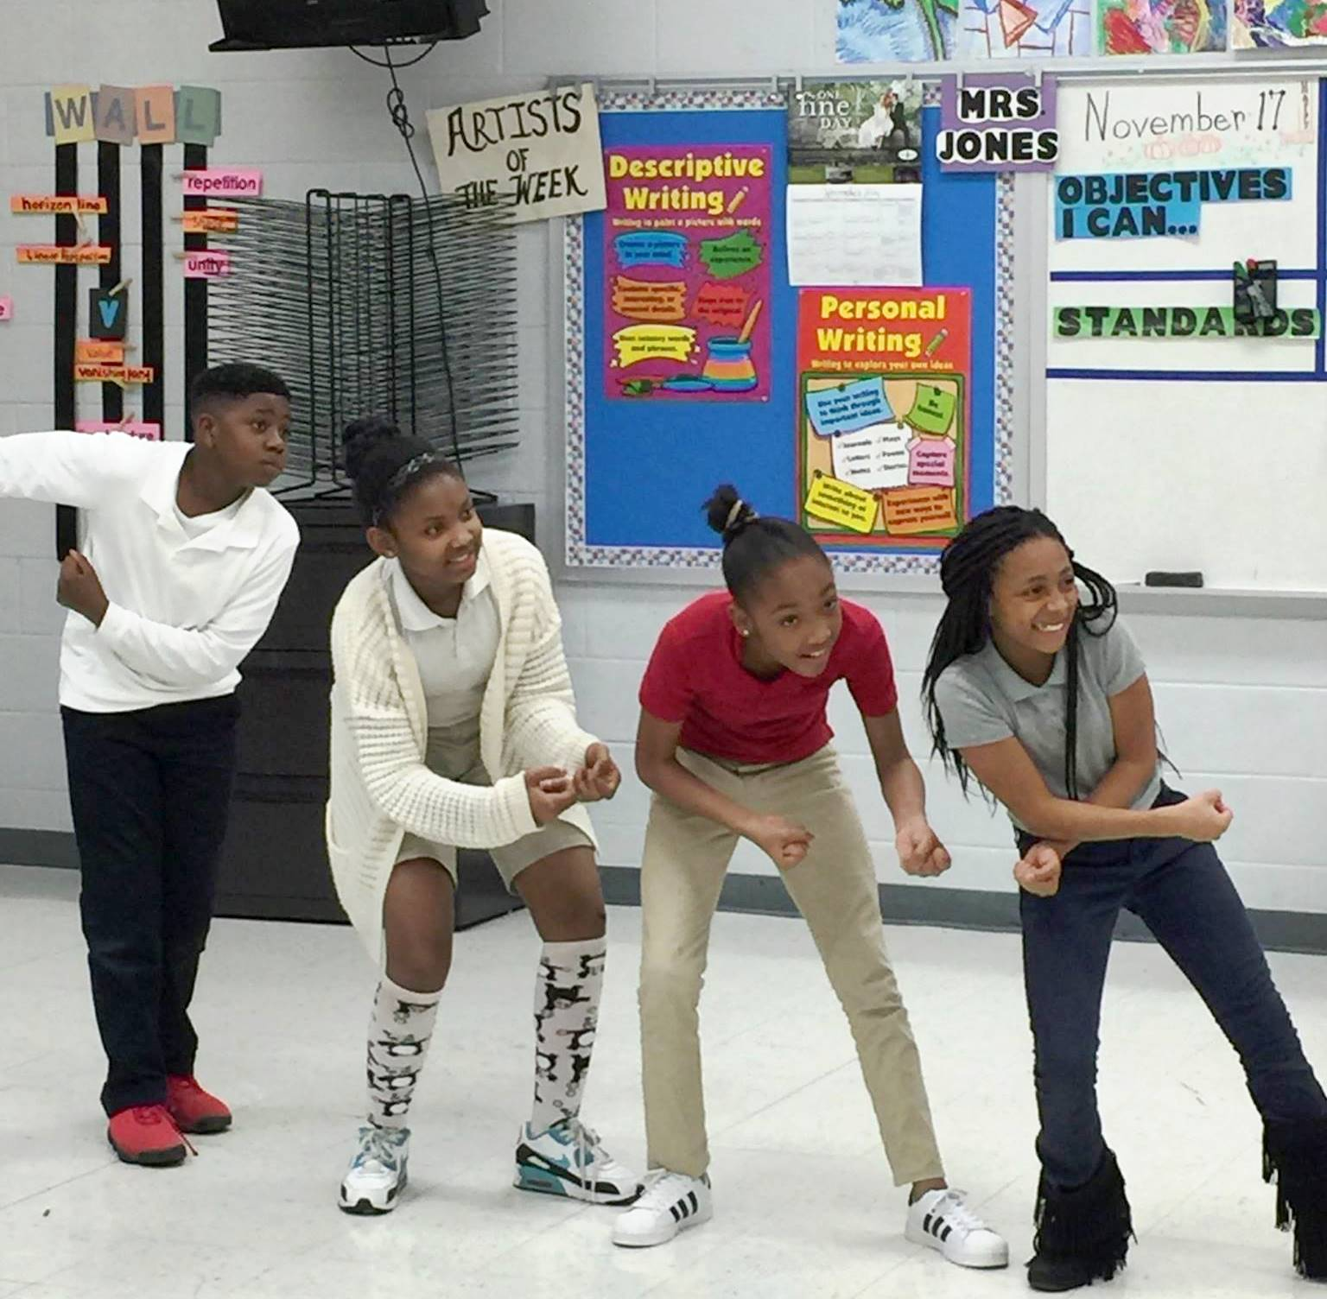
Nashville After Zone Alliance
PURPOSE
To strengthen free, high-quality out-of-school time opportunities that prepare Nashville public school students to succeed in middle school and beyond.
Anna Harutyunyan, NAZA Coordinator

Slide 4
The NAZA Afterschool System:
Acts as an intermediary between Metro Government and out-of-school time program (OST) providers
Funds program providers on an annual, competitive basis
Sets quality standards, monitors programs, evaluates programs’ quality (through the YPQA), and tracks student satisfaction, program quality, and attendance data
Provides support to programs on best practices for engaging students in literacy and STEM in the afterschool hours
Provides free-of-charge professional development and coaching for youth workers with the aim of supporting the overall quality of programs

Slide 5
NAZA Offers the Following Resources to Funded Program Providers:
Access to afternoon and late buses in partnership with MNPS (when possible)
Access to afternoon snacks or meals in partnership with MNPS through a federal grant
Program spaces in partnership with MNPS and community organizations
Professional development opportunities, coaching, resources, materials, and library resources (e.g. Limitless Libraries)
New and innovative approaches and models on how to increase motivation and interest in literacy and STEM in partnership with national institutions (Wallace, Rand, Every Hour Counts, Noyce)

Slide 6
NAZA Aims to:
Help youth stay engaged in middle school, transition to high school successfully, and graduate from high school
Help youth build hard and soft skills
Expose youth to post-secondary education and career opportunities
Expose youth to enrichment opportunities
Strengthen the capacity of youth serving organizations throughout the city to deliver high-quality OST programs

Slide 7
NAZA Students Benefit from:
A safe and supportive environment that fosters students’ positive development, helps them academically, and provides them with enrichment opportunities through:
  Opportunities to develop relationships with caring adults & peers
  Time for homework help and access to engaging activities (some activities designed to increase their interest in literacy and STEM)
  Skill building opportunities where they gain skills needed for education, employment and life (e.g. 21st Century skills)
  Exposure to different professions and opportunities
  Voice and choice in activities

Slide 8
Data Tracked by NAZA:
Student daily attendance through SportUp, that is further bridged to MNPS’ Data Warehouse
Student satisfaction through the Youth Asset Survey (YAS)
Program staff satisfaction through an annual staff survey
Quality of instruction through YPQA observation
Student interest and motivation in literacy through the YAS and quality of literacy opportunities offered through the YPQA
Quality of STEM programming through the Dimensions of Success tool and students’ engagement in STEM and acquisition of 21st Century skills through the Common Instrument

Slide 9
What Does the Research Show?
According to the American Institutes for Research study of 3 cities in 2014, higher levels of attendance in high-quality NAZA-funded programs was correlated with fewer school-day tardies, fewer disciplinary incidents, and greater improvement in math and science grades
According to the 2017 NAZA evaluation conducted by Peabody College:
  NAZA students showed better growth in school attendance relative to comparison students
  NAZA students showed better growth on a school discipline outcome relative to comparison students
  Students who participated in NAZA longer experienced better growth in TCAP scores and school attendance, demonstrated greater decreases in truancy offenses over time, and showed higher PLAN percentile scores

Slide 10
How Did We Do Last Year?
Students’ Positive Identity: According to the 2016-2017 Youth Asset Survey results, 92% of NAZA participants agreed that their NAZA-funded programs’ activities helped them:
  Learn to be a team player
  Learn that they could do things that they did not think they could do
  Feel successful in the activities that they participated in
Literacy:
  66% of students said they like to read for fun
  69% of students said they like to write for fun
  89% of students said that adults in their afterschool program encouraged them to read and write in their afterschool program
Partnership with Schools: 56% of surveyed managers mentioned they need more connections to schools
Overall Instructional Quality: Improved from fall of 2016 to spring of 2017 in 32 out of 42 program sites
Notes:
NAZA programs help students to understand respect and responsibility, and to build collaboration and positive communication skills.

Slide 11
2016-2017 YPQA Pre-and Post-External Assessment Results- NAZA Network Aggregate

Slide 12
2016-2017 YPQA Literacy Scale Results – NAZA Network Aggregate of External Assessments
YPQA Plus Literacy | PQA Fall 2016 (n=42) /5 | PQA Spring 2017 (n=42) /5 | PQA Change 2016-17 (n=42)
Literacy Scale Overall Score | 3.51 | 4.13 | +0.63
Literacy 1. Student participation in literacy activities | 3.76 | 4.67 | +0.91
Literacy 2. Youth have opportunities to read in multiple contexts | 3.62 | 4.24 | +0.62
Literacy 3. Staff encourages youth to write | 3.19 | 3.33 | +0.14
Literacy 4. Staff talk with students about vocabulary multiple times | 2.76 | 3.86 | +1.10
Literacy 5. Availability of materials and places for free reading | 3.95 | 4.38 | +0.43
Literacy 6. Youth experience multiple literacy activities | 3.76 | 4.33 | +0.57

Slide 13
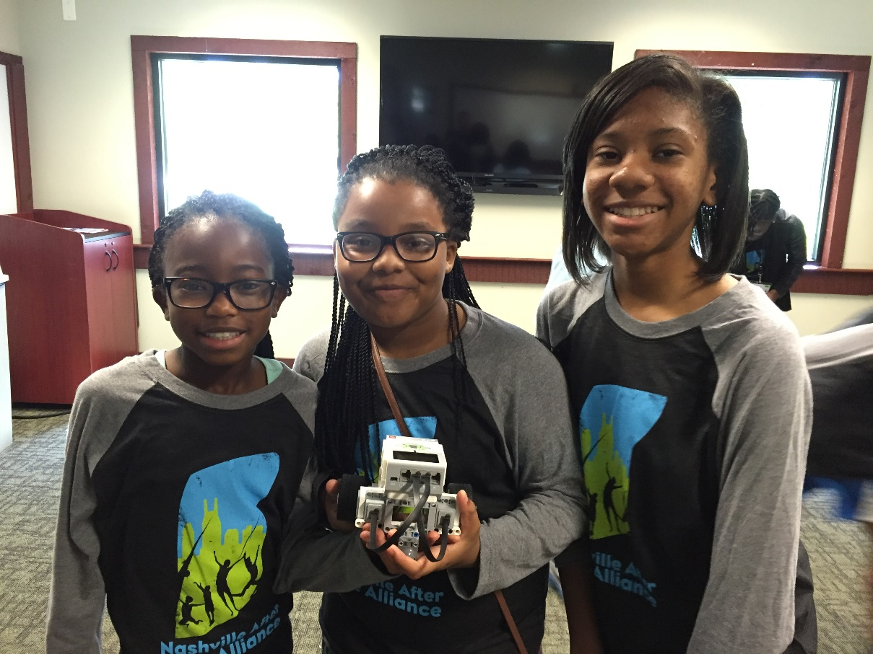
Next to Laura Hansen
THANK YOU

Slide 14
Responsible Use of Data
Laura Hansen

Slide 15
Lunch and Learn
Featuring a panel discussion with:
  Cassie Deas, Metro Parks
  Jennifer DeWall, Wright Middle Prep
  Patricia Madera, Conexión Americas
Introduce yourself at your table.
Notes:
We are here today for a NAZA data dive. We began these data dives back in 2013 as a way for schools and NAZA programs to collaborate and partner for supporting student success. The last one we had was in 2015. After that one, NAZA went through a transition period by changing directors and while we planned to have a data dive last year, the timing wasn’t right.
Nonetheless, Wright Middle continued to host regular data dives with NAZA partners. With that being said, let’s start off by allowing you to introduce yourself, your organization, and your role in the NAZA data dive.
Question:
•Why did you continue having data dives the past couple of years?
•What were the benefits of having the regular data dives?
•What words of wisdom would you give to us today for hosting regular data dives?
Any questions from the audience?

Slide 16
Collaborative Inquiry Data Dive
Margie Johnson, Ed.D.

Slide 17

Outcome
Our outcome is to model the collaborative inquiry process for analyzing data and partnering for supporting student success.

Slide 18

Partner Share
Partner Share—Getting Acquainted
Review the Partner Share Form.
Discuss the questions provided on the form.

Slide 19

Data have no meaning. Meaning is imposed through interpretation
(Wellman & Lipton, 2004, pp. ix-xi).

Slide 20
How do we bridge the gap between data and results, so all students have educational success?
What is the bridge made of?
Collaborative
Inquiry
Data
Results
Love, 2009

Slide 21
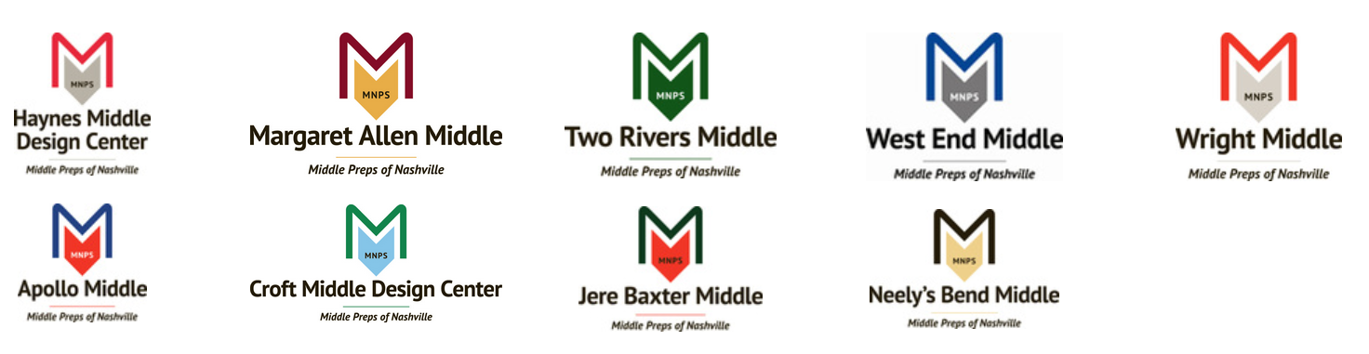
MNPS Collaborative Inquiry
Collaborative Inquiry is a data-based team process that consciously uses the collaborative learning cycle (activating and engaging, exploring and discovering, and organizing and integrating) and the qualities of effective groups (fostering a culture of trust, maintaining a clear focus, taking collective responsibility and data-informed decision-making).
MNPS Collaborative Inquiry Community of Practice

Slide 22
Collaborative Inquiry Cycle
Organizing and Integrating
What inferences, explanations, or conclusions might we draw?
What additional data sources might verify our explanations?
What solutions might we explore?
What data will we need to guide implementation?
Activating and Engaging
What assumptions do we bring?
What are some predictions we are making?
What questions are we asking?
What are some possibilities for learning?
Managing
Modeling
Mediating
Monitoring
Exploring and Discovering
What important points seem to pop out?
What patterns, categories, or trends are emerging?
What seems to be surprising or unexpected?
What are some ways we have not yet explored these data?
--Lipton, L. & Wellman, B. (2012

Slide 23
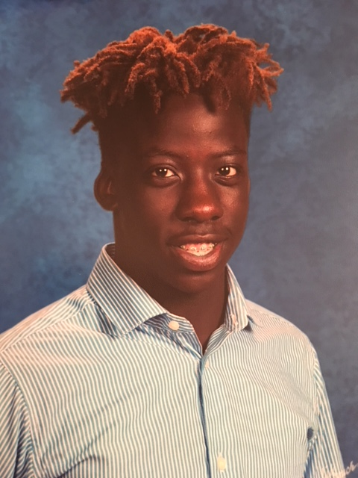
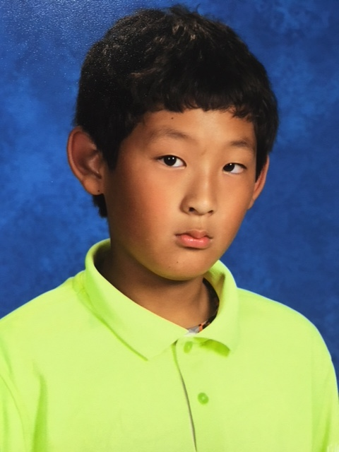
Calibrating Activity—Making Observations

Slide 24
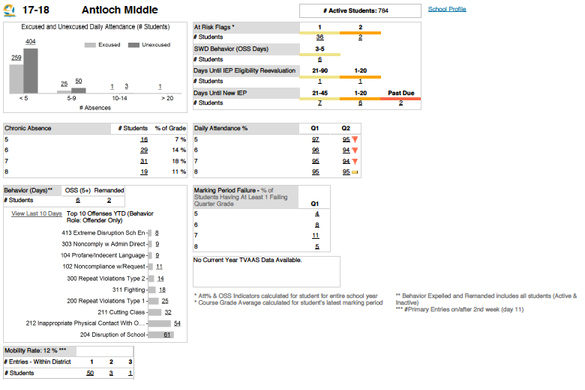

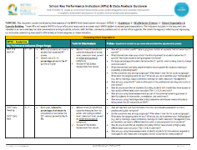
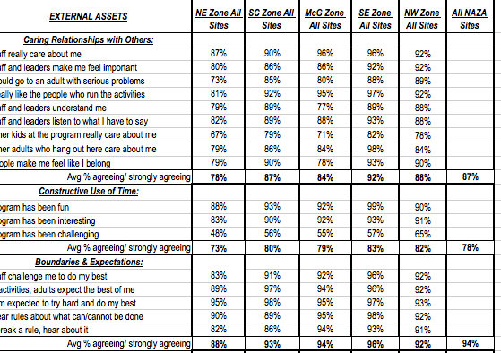
Exploring and Discovering—Data Dive
School Dashboard
MNPS KPIs
NAZA Youth Asset Survey
Notes:
As you are reviewing these data sets, what observations jump out at you?

Slide 25
Collaborative Learning Cycle
Organizing and Integrating
Activating and Engaging
What assumptions do we bring?
Managing
Modeling
Mediating
Monitoring
Exploring and Discovering
--Lipton, L. & Wellman, B. (2012

Slide 26
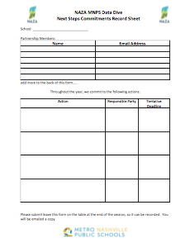
Next Steps Commitments
One thing that I commit to do for you…..
One thing that you commit to do for me…..
One thing that we commit to do together……
Record on the Next Steps Commitment Sheets along with proposed deadline.

Slide 27
Reflection, Feedback, and Wrap-Up

Slide 28

Exit Ticket Reflection
Given what we have discussed and learned today, what might be some actions you take?

Slide 29

Feedback---
How Was Today’s Meeting
Individually
  Use a post-it note to provide feedback.

Slide 30
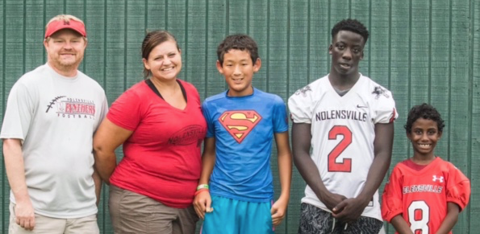
Wrap Up

Slide 31
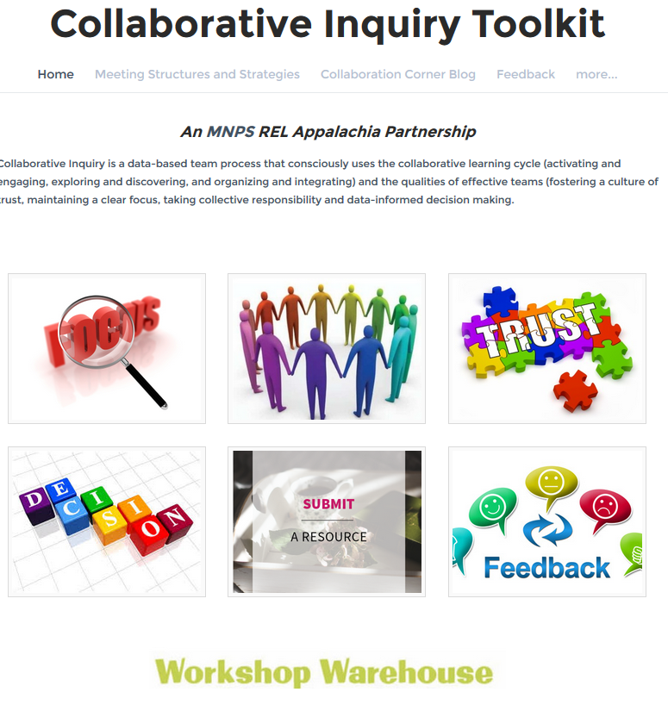


MNPS Collaborative Inquiry Toolkit
www.mnpscollaboration.org

Slide 32
References
Lipton, L. & Wellman, B. (2012). Got data? Now what? Bloomington, IN: Solution Tree.
Lipton, L. & Wellman, B. (2011). Groups at work: Strategies and structures for professional learning. Sherman, CT: MiraVia, LLC.
Love, N. (2009). Using data to improve learning for all: A collaborative inquiry approach. Thousand Oaks, CA: Corwin.

